Slide 1
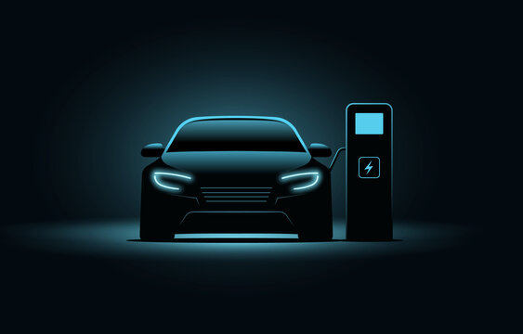
IOT Based E-Vehicle Battery Optimization
TEAM NAME : Tech Titanz
TEAM ID : T3PSO1T01
Keerthana P
Gayathri V
Harini SS
Harini S

Slide 2

INTRODUCTION
Electric vehicles (EVs) are currently the world's emerging technology for sustainable and eco-friendly transportation. They leverage advanced battery technology but face significant challenges in battery management, such as energy density and charging infrastructure. Consequently, these issues prevent EVs from fully occupying the market.

Slide 3

ADDRESSED PROBLEMS
Absence of timely battery status updates.
Challenges in finding charging stations.
Uncertainty about available slots, leading to delays.
Restricted range due to single battery setup.
Insufficient self-charging facilities.
Limited user interaction opportunities.
Inadequate of battery health degradation.

Slide 4



Onboard User Interface Installed in EV Display, that displays
Real-Time Battery Monitoring
Geolocation-Based Charging Station Locator
Charging Slot Availability Information
Slot Booking Facility
OBJECTIVE
Automatic Battery Switching for Extended Range
Solar Charging for Extended Battery Life
Battery cooling system using AI

Slide 5

SDG’S
SDG 7 - Affordable and Clean Energy
SDG 9 - Industry ,Innovation and Infrastructure
SDG 11 - Sustainable Cities and Communities
SDG 12 - Responsible Consumption and Production
Automatic Battery Switching for Extended Range
Soar Charging for Extended Battery Life
Battery cooling system using AI

Slide 6






SOLUTION
Onboard User Interface Installed in E-vehicle Display
Real-Time Battery Monitoring
Geolocation-Based Charging Station Locator
Dual batteries for extended range, automatically switching between them when one reaches its threshold battery percentage ensuring continuous power for long range
BATTERY 1
BATTERY 2
YOU
BATTERY
STATUS
CHARGING STATION

Slide 7
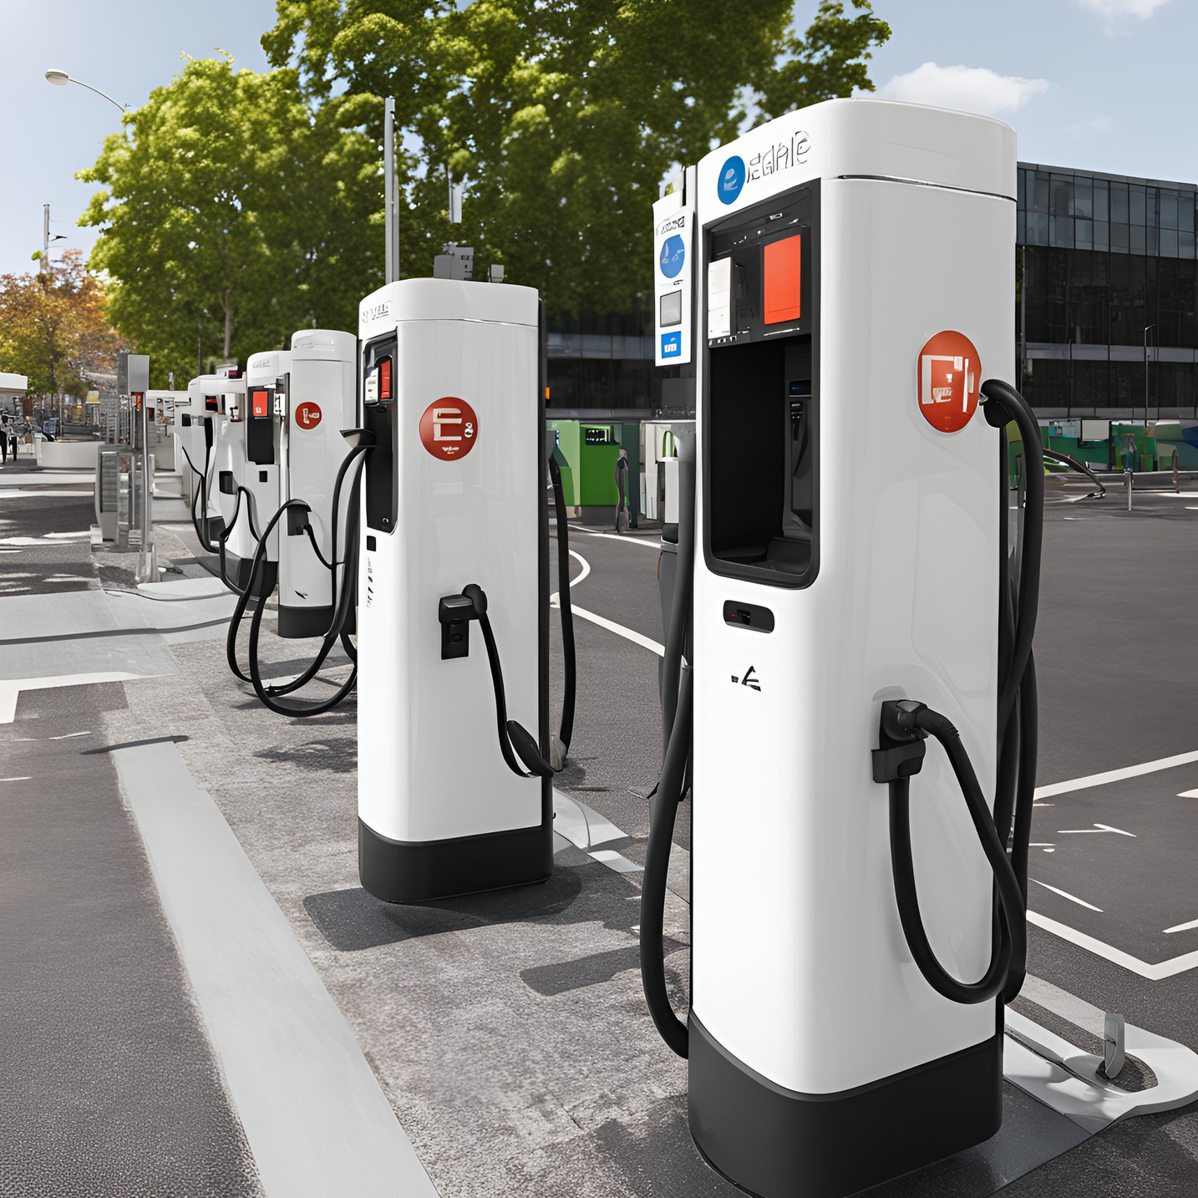
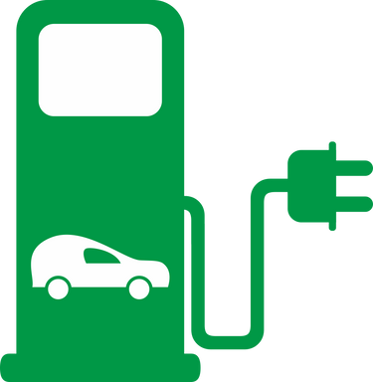

Users receive real-time updates on the availability of charging slots at selected stations and can
E-station 1
Total Slots : 12
Unreserved Slots : 4
Users can access real-time information on available charging slots nearby and reserve them accordingly.
RESERVE

Slide 8

Solar charging reduces reliance on traditional charging systems, enhancing sustainability and extending vehicle range.
Automatic cooling of the battery using Peltier modules enhances battery performance
BATTERY 1
BATTERY 2
Automatic Cooling System

Slide 9
TOOLS AND TECHNOLOGIES
HARDWARE:
• Dual Battery System: Provides continuous power supply by switching between two batteries.
• OLED Display: Shows real-time status updates to users.
• Drive Motor: Propels the vehicle.
• Relays: Facilitates seamless switching between batteries and solar panels.
• Peltier Cooling System: Regulates battery temperature to prevent overheating.
• GPS Technology: Locates EV stations and the vehicle’s current position.
SOFTWARE:
• Web Development: HTML, CSS for creating the user interface.
• Database Management: MySQL for storing and managing data.
• Web Hosting: Deployed on the 000webhost server.

Slide 10
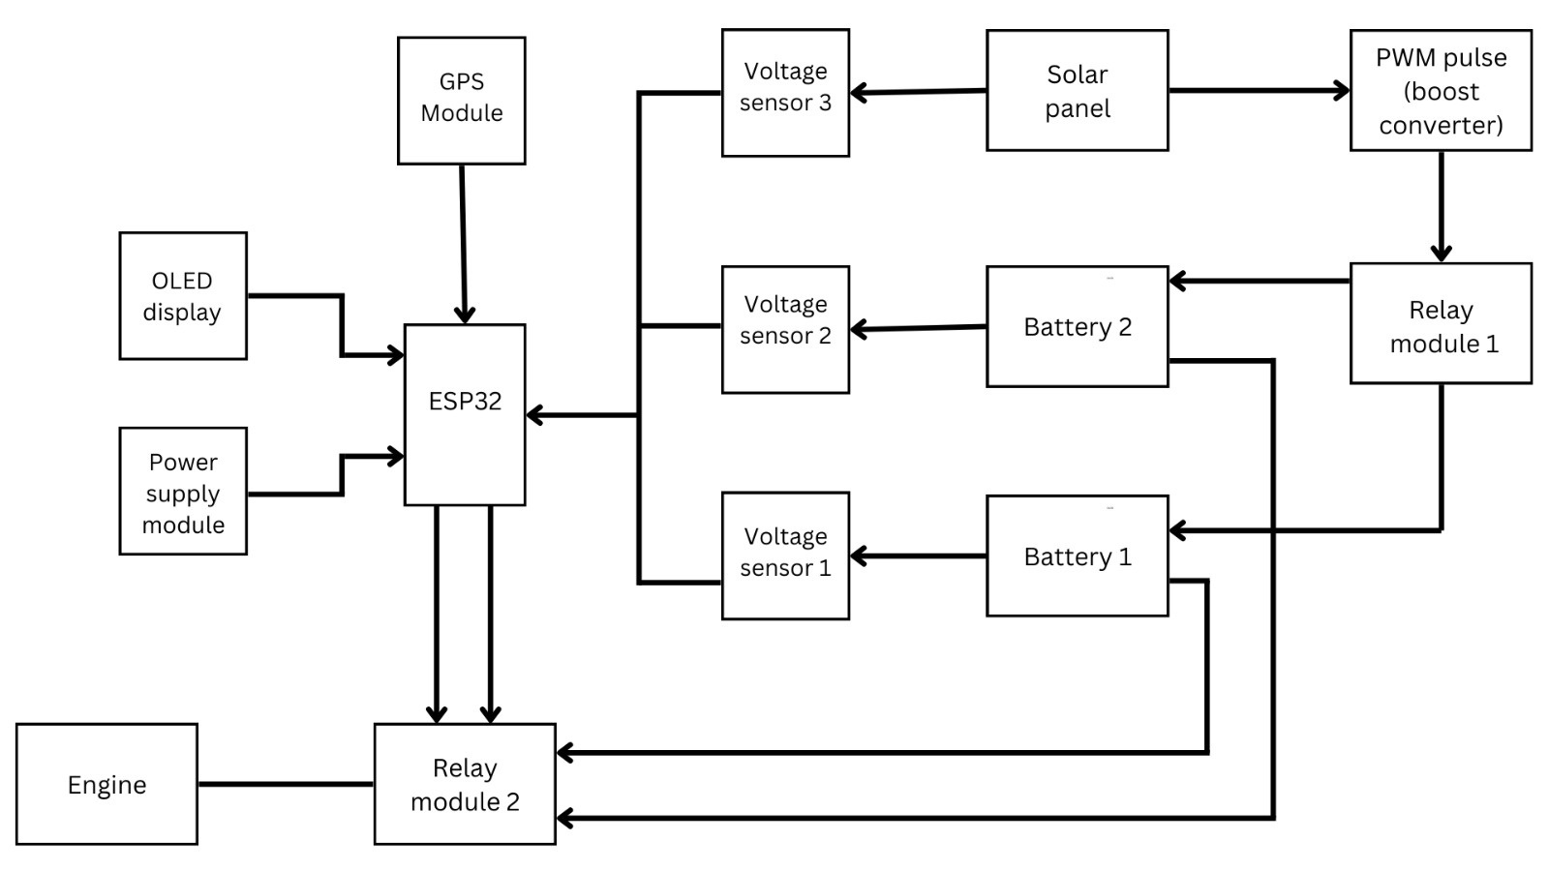
BLOCK DIAGRAM

Slide 11
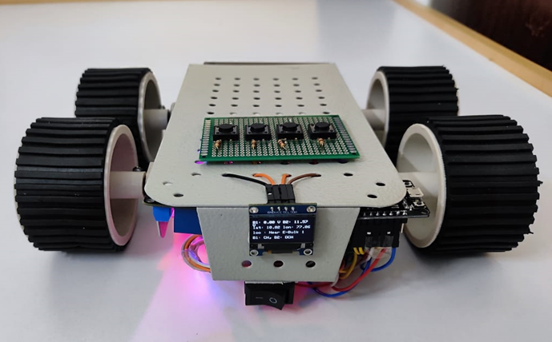
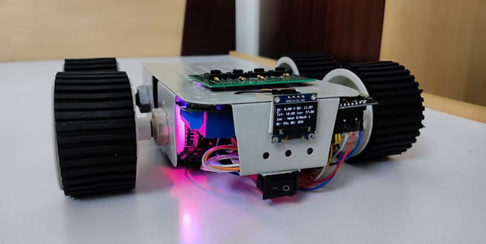
HARDWARE PROTOTYPE
Prototype Drive Link
https://drive.google.com/file/d/1J3ZJTmL9KbbzgoVLI1zwpxfAWqdJDcfd/view?usp=sharing

Slide 12
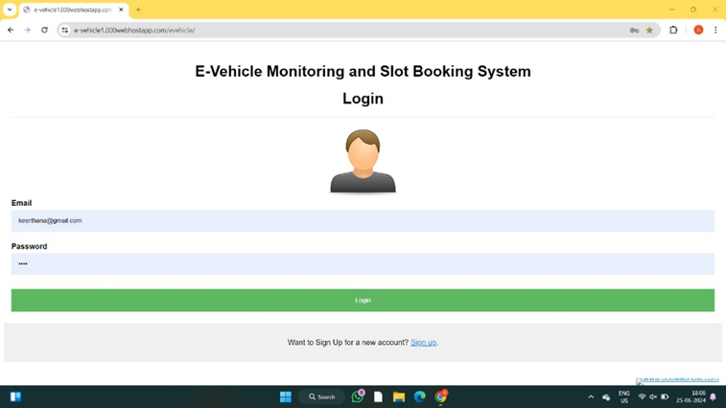
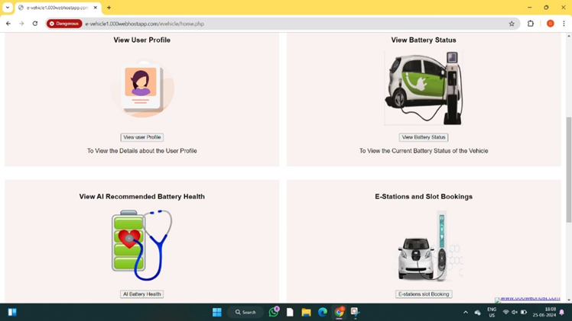
SOFTWARE PROTOTYPE
Webpage Link: https://labgenicx.shop/evehicle/
USER LOGIN
DASHBOARD

Slide 13
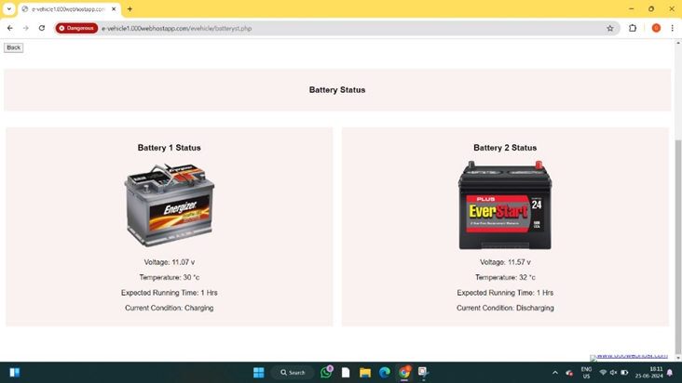
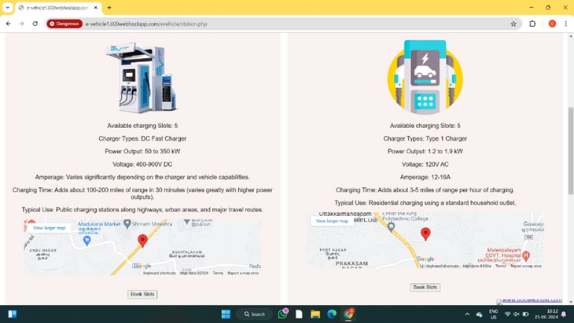
SOFTWARE PROTOTYPE
BATTERY STATUS
EV STATION DETAILS

Slide 14
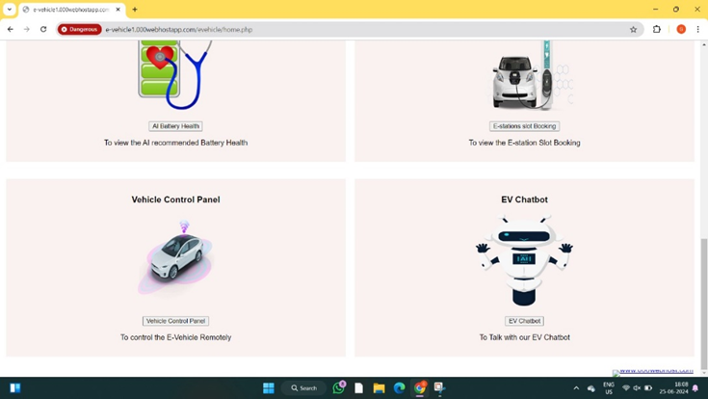
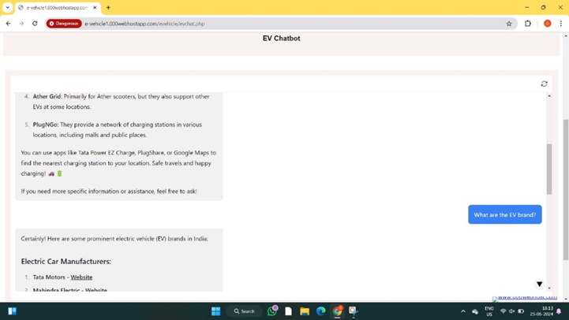
SOFTWARE PROTOTYPE
DASHBOARD
EV CHATBOT

Slide 15
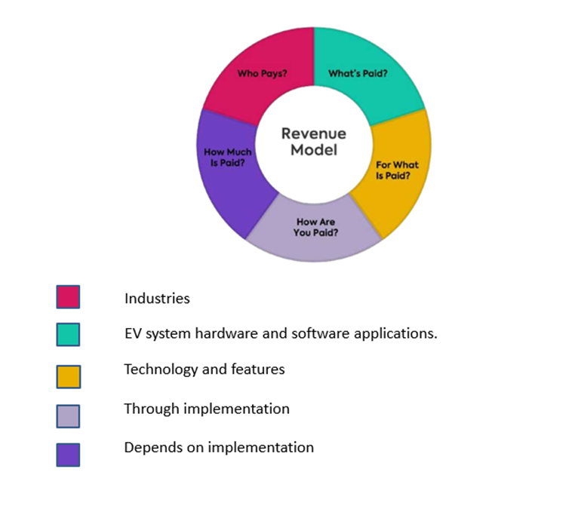
FUTURE SCOPE
Future enhancements for this project could include renewable energy integration to enhance sustainability and performance. AI based prediction health monitoring of the battery.

Slide 16
THANK YOU

